Slide 1
LINEAR PROGRAMMING: THE GRAPHICAL METHOD
Linear Programming Problem
Properties of LPs
LP Solutions
Graphical Solution
Introduction to Sensitivity Analysis

Slide 2
Linear Programming (LP) Problem
A mathematical programming problem is one that seeks to maximize or minimize an objective function subject to constraints.
If both the objective function and the constraints are linear, the problem is referred to as a linear programming problem.
Linear functions are functions in which each variable appears in a separate term raised to the first power and is multiplied by a constant (which could be 0).
Linear constraints are linear functions that are restricted to be "less than or equal to", "equal to", or "greater than or equal to" a constant.

Slide 3
Linear Programming (LP) M
There are five common types of decisions in which LP may play a role
Product mix- blending problem in mining
Production plan
Ingredient mix-plant concentration
Transportation
Assignment- workers job distribution

Slide 4
Steps in Developing a Linear Programming (LP) Model
Formulation
Solution
Interpretation and Sensitivity Analysis

Slide 5
Steps in Formulating LP Problems
1. Define the objective. (min or max)
2. Define the decision variables. (positive, binary) ?
3. Write the mathematical function for the objective.
4. Write a 1- or 2-word description of each constraint.
Write the right-hand side (RHS) of each constraint.
Also called resources
6. Write <, =, or > for each constraint.
7. Write the decision variables on LHS of each constraint.
8. Write the coefficient for each decision variable in each constraint.

Slide 6
Properties of LP Models
Seek to minimize or maximize
Include “constraints” or limitations
There must be alternatives available
All equations are linear

Slide 7
LP Problems in: Product Mix
Objective
To select the mix of products or services that results in maximum profits for the planning period
Decision Variables
How much to produce and market of each product or service for the planning period
Constraints
Maximum amount of each product or service demanded; Minimum amount of product or service policy will allow; Maximum amount of resources available

Slide 8
Example LP Model Formulation: The Product Mix Problem
Decision: How much to make of > 2 products?
Objective: Maximize profit
Constraints: Limited resources

Slide 9
Example: Pine Furniture Co.
Two products: Chairs and Tables
Decision: How many of each to make this
month?
Objective: Maximize profit

Slide 10
Pine Furniture Data
 | Tables (per table) | Chairs (per chair) | Hours Available
Profit Contribution | $7 | $5
Carpentry | 3 hrs | 4 hrs | 2400
Painting | 2 hrs | 1 hr | 1000
Other Limitations:
Make no more than 450 chairs
Make at least 100 tables

Slide 11
Constraints:
Have 2400 hours of carpentry time available
3 T + 4 C < 2400 (hours)
Have 1000 hours of painting time available
2 T + 1 C < 1000 (hours)

Slide 20
More Constraints:
Make no more than 450 chairs
C < 450 (num. chairs)
Make at least 100 tables
T > 100 (num. tables)
Non-negativity:
Cannot make a negative number of chairs or tables
T > 0
C > 0

Slide 21
Model Summary
Max 7T + 5C (profit)
Subject to the constraints:
3T + 4C < 2400 (carpentry hrs)
2T + 1C < 1000 (painting hrs)
C < 450 (max # chairs)
T > 100 (min # tables)
T, C > 0 (nonnegativity)

Slide 22
Graphical Solution
Graphing an LP model helps provide insight into LP models and their solutions.
While this can only be done in two dimensions, the same properties apply to all LP models and solutions.

Slide 23
LP Characteristics
Feasible Region: The set of points that satisfies all constraints
Corner Point Property: An optimal solution must lie at one or more corner points
Optimal Solution: The corner point with the best objective function value is optimal

Slide 24
C
600
0
Carpentry
Constraint Line
3T + 4C = 2400
Intercepts
(T = 0, C = 600)
(T = 800, C = 0)
Infeasible
> 2400 hrs
3T + 4C = 2400
Feasible
< 2400 hrs
0 800 T

Slide 25
C
1000
600
0
Painting
Constraint Line
2T + 1C = 1000
Intercepts
(T = 0, C = 1000)
(T = 500, C = 0)
2T + 1C = 1000
0 500 800 T

Slide 26
C
1000
600
450
0
Max Chair Line
C = 450
Min Table Line
T = 100
Feasible
Region
0 100 500 800 T

Slide 27
C
500
400
300
200
100
0
Objective Function Line
7T + 5C = Profit
7T + 5C = $4,040
Optimal Point
(T = 320, C = 360)
7T + 5C = $2,800
7T + 5C = $2,100
0 100 200 300 400 500 T

Slide 28
C
500
400
300
200
100
0
Additional Constraint
Need at least 75 more chairs than tables
C > T + 75
Or
C – T > 75
New optimal point
T = 300, C = 375
T = 320
C = 360
No longer feasible
0 100 200 300 400 500 T

Slide 29
Special Situation in LP
Redundant Constraints - do not affect the feasible region
Example: x < 10
x < 12
The second constraint is redundant because it is less restrictive.

Slide 30
Special Situation in LP
Infeasibility – when no feasible solution exists (there is no feasible region)
Example: x < 10
x > 15

Slide 31
Special Situation in LP
Alternate Optimal Solutions – when there is more than one optimal solution
C
10
6
0
Max 2T + 2C
Subject to:
T + C < 10
T < 5
C < 6
T, C > 0
2T + 2C = 20
All points on Red segment are optimal
0 5 10 T

Slide 32
Special Situation in LP
Unbounded Solutions – when nothing prevents the solution from becoming infinitely large
C
2
1
0
Direction of solution
Max 2T + 2C
Subject to:
2T + 3C > 6
T, C > 0
0 1 2 3 T

Slide 33
Building Linear Programming Models
1. What are you trying to decide - Identify the decision variable to solve the problem and define appropriate variables that represent them. For instance, in a simple maximization problem, RMC, Inc. interested in producing two products: fuel additive and a solvent base. The decision variables will be X1 = tons of fuel additive to produce, and X2 = tons of solvent base to produce.
2. What is the objective to be maximized or minimized? Determine the objective and express it as a linear function. When building a linear programming model, only relevant costs should be included, sunk costs are not included. In our example, the objective function is: z = 40X1 + 30X2; where 40 and 30 are the objective function coefficients.

Slide 34
Building Linear Programming Models
3. What limitations or requirements restrict the values of the decision variables? Identify and write the constraints as linear functions of the decision variables. Constraints generally fall into one of the following categories:
a. Limitations - The amount of material used in the production process cannot exceed the amount available in inventory. In our example, the limitations are:
Material 1 = 20 tons
Material 2 = 5 tons
Material 3 = 21 tons available.
The material used in the production of X1 and X2 are also known.

Slide 35
Building Linear Programming Models
To produce one ton of fuel additive uses .4 ton of material 1, and .60 ton of material 3. To produce one ton of solvent base it takes .50 ton of material 1, .20 ton of material 2, and .30 ton of material 3. Therefore, we can set the constraints as follows: .4X1 + .50 X2 <= 20 .20X2 <= 5 .6X1 + .3X2 <=21, where .4, .50, .20, .6, and .3 are called constraint coefficients. The limitations (20, 5, and 21) are called Right Hand Side (RHS).
b. Requirements - specifying a minimum levels of performance. For instance, production must be sufficient to satisfy customers’ demand.

Slide 36
LP Solutions
The maximization or minimization of some quantity is the objective in all linear programming problems.
A feasible solution satisfies all the problem's constraints.
Changes to the objective function coefficients do not affect the feasibility of the problem.
An optimal solution is a feasible solution that results in the largest possible objective function value, z, when maximizing or smallest z when minimizing.
In the graphical method, if the objective function line is parallel to a boundary constraint in the direction of optimization, there are alternate optimal solutions, with all points on this line segment being optimal.

Slide 37
LP Solutions
A graphical solution method can be used to solve a linear program with two variables.
If a linear program possesses an optimal solution, then an extreme point will be optimal.
If a constraint can be removed without affecting the shape of the feasible region, the constraint is said to be redundant.
A nonbinding constraint is one in which there is positive slack or surplus when evaluated at the optimal solution.
A linear program which is overconstrained so that no point satisfies all the constraints is said to be infeasible.

Slide 38
LP Solutions
A feasible region may be unbounded and yet there may be optimal solutions. This is common in minimization problems and is possible in maximization problems.
The feasible region for a two-variable linear programming problem can be nonexistent, a single point, a line, a polygon, or an unbounded area.
Any linear program falls in one of three categories:
is infeasible
has a unique optimal solution or alternate optimal solutions
has an objective function that can be increased without bound

Slide 39
Example: Graphical Solution
Solve graphically for the optimal solution:
Min z = 5x₁ + 2x₂
s.t. 2x₁ + 5x₂ > 10
4x₁ - x₂ > 12
x₁ + x₂ > 4
x₁, x₂ > 0

Slide 40
Example: Graphical Solution
Graph the Constraints
Constraint 1: When x₁ = 0, then x₂ = 2; when x₂ = 0, then x₁ = 5. Connect (5,0) and (0,2). The ">" side is above this line.
Constraint 2: When x₂ = 0, then x₁ = 3. But setting x₁ to 0 will yield x₂ = -12, which is not on the graph. Thus, to get a second point on this line, set x₁ to any number larger than 3 and solve for x₂: when x₁ = 5, then x₂ = 8. Connect (3,0) and (5,8). The ">" side is to the right.
Constraint 3: When x₁ = 0, then x₂ = 4; when x₂ = 0, then x₁ = 4. Connect (4,0) and (0,4). The ">" side is above this line.

Slide 41
Example: Graphical Solution
Constraints Graphed
x₂
Feasible Region
5
4
3
2
1
4x₁ - x₂ > 12
x₁ + x₂ > 4
2x₁ + 5x₂ > 10
1 2 3 4 5 6
x₁

Slide 42
Example: Graphical Solution
Graph the Objective Function
Set the objective function equal to an arbitrary constant (say 20) and graph it. For 5x₁ + 2x₂ = 20, when x₁ = 0, then x₂ = 10; when x₂= 0, then x₁ = 4. Connect (4,0) and (0,10).
Move the Objective Function Line Toward Optimality
Move it in the direction which lowers its value (down), since we are minimizing, until it touches the last point of the feasible region, determined by the last two constraints. This is called the Iso-Value Line Method.

Slide 43
Example: Graphical Solution
Objective Function Graphed
x₂
Min z = 5x₁ + 2x₂
4x₁ - x₂ > 12
x₁ + x₂ > 4
5
4
3
2
1
2x₁ + 5x₂ > 10
1 2 3 4 5 6
x₁

Slide 44
Example: Graphical Solution
Solve for the Extreme Point at the Intersection of the Two Binding Constraints
4x₁ - x₂ = 12
x₁+ x₂ = 4
Adding these two equations gives:
5x₁ = 16 or x₁ = 16/5.
Substituting this into x₁ + x₂ = 4 gives: x₂ = 4/5
Solve for the Optimal Value of the Objective Function
Solve for z = 5x₁ + 2x₂ = 5(16/5) + 2(4/5) = 88/5.
Thus the optimal solution is
x₁ = 16/5; x₂ = 4/5; z = 88/5

Slide 45
Example: Graphical Solution
x₂
Min z = 5x₁ + 2x₂
4x₁ - x₂ > 12
x₁ + x₂ > 4
5
4
3
2
1
2x₁ + 5x₂ > 10
Optimal: x₁ = 16/5
x₂ = 4/5
1 2 3 4 5 6
x₁

Slide 46
POST OPTIMALITY ANALYSIS
How sensitive our solution is to the external environmental changes
Such as
Change in market selling price per ton of ore/coal
Change in production cost of material
Change in size and number of equipment
How are these changes going to affect our OPTIMAL SOLUTION

Slide 47
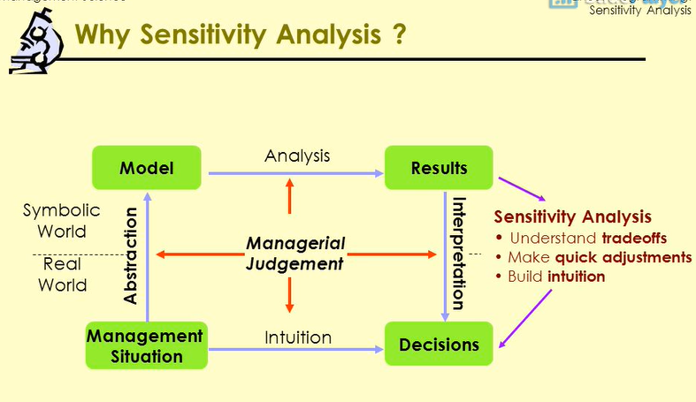

Slide 48
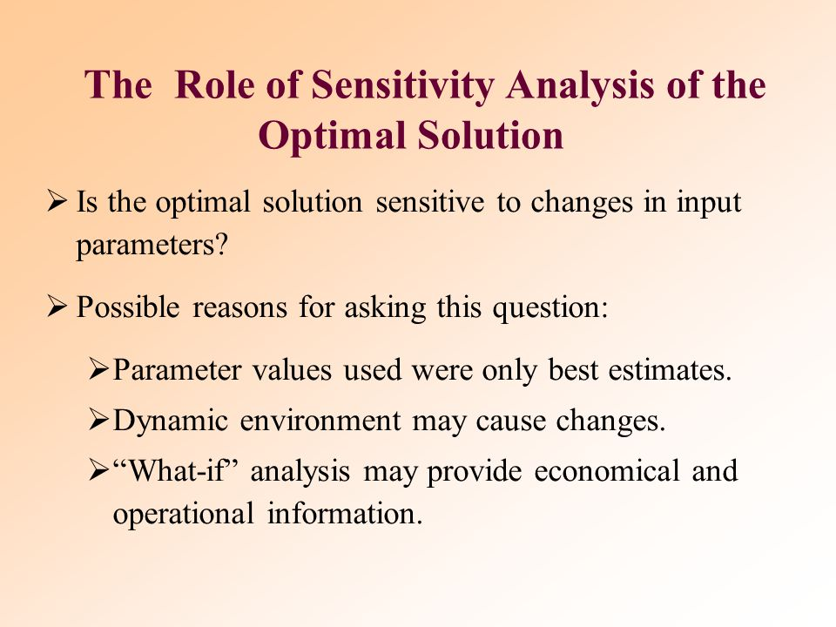

Slide 49
Sensitivity Analysis
Sensitivity analysis is used to determine effects on the optimal solution within specified ranges for the objective function coefficients, constraint coefficients, and right hand side values.
Sensitivity analysis provides answers to certain what-if questions.

Slide 50
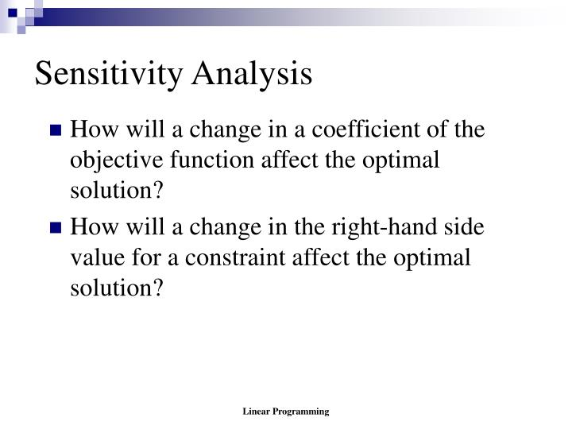

Slide 51
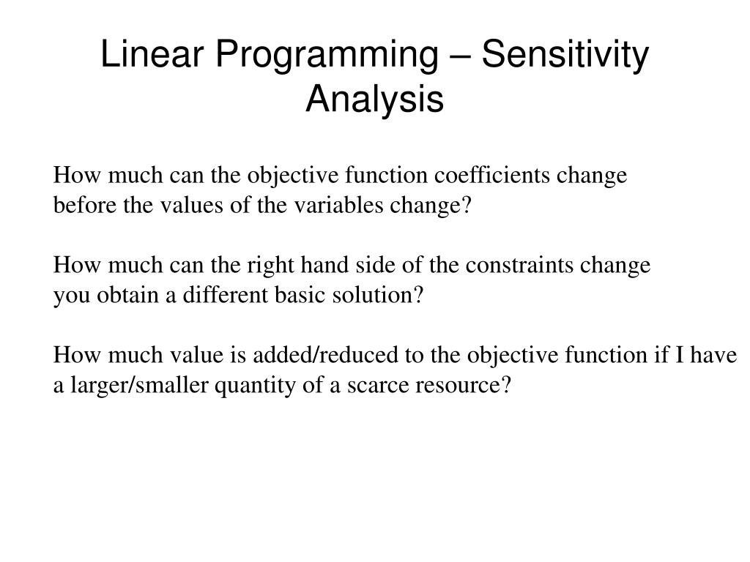

Slide 52
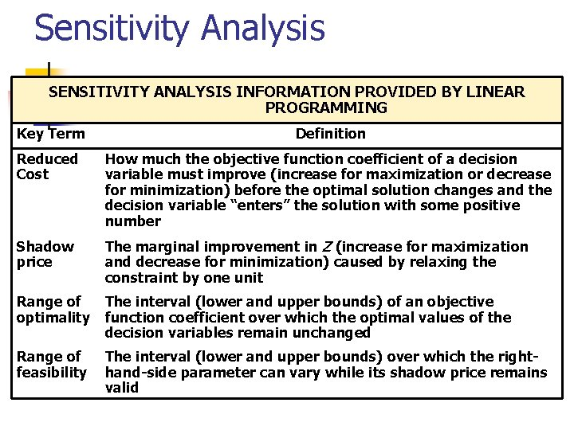
TERMS

Slide 53
Range of Optimality
A range of optimality of an objective function coefficient is found by determining an interval for the objective function coefficient in which the original optimal solution remains optimal while keeping all other data of the problem constant. The value of the objective function may change in this range.
Graphically, the limits of a range of optimality are found by changing the slope of the objective function line within the limits of the slopes of the binding constraint lines. (This would also apply to simultaneous changes in the objective coefficients.)
The slope of an objective function line, Max c₁x₁ + c₂x₂, is -c₁/c₂, and the slope of a constraint, a₁x₁ + a₂x₂ = b, is -a₁/a₂.

Slide 54
Example: Sensitivity Analysis
Solve graphically for the optimal solution:
Max z = 5x₁ + 7x₂
s.t. x₁ < 6
2x₁ + 3x₂ < 19
x₁ + x₂ < 8
x₁, x₂ > 0
The slope of an objective function line, Max c₁x₁ + c₂x₂, is -c₁/c₂, and the slope of a constraint, a₁x₁ + a₂x₂ = b, is -a₁/a₂.

Slide 55
Example: Sensitivity Analysis
Graphical Solution
x₂
x₁ + x₂ < 8
8
7
6
5
4
3
2
1
1 2 3 4 5 6 7 8 9 10
Max 5x₁ + 7x₂
x₁ < 6
Optimal x₁ = 5, x₂ = 3
z = 46
2x₁ + 3x₂ < 19
x₁

Slide 56
Example: Sensitivity Analysis
Range of Optimality for c₁
The slope of the objective function line is -c₁/c₂. The slope of the first binding constraint, x₁ + x₂ = 8, is -1 and the slope of the second binding constraint, x₁ + 3x₂ = 19, is -2/3.
Find the range of values for c₁ (with c₂ staying 7) such that the objective function line slope lies between that of the two binding constraints:
-1 < -c₁/7 < -2/3
Multiplying through by -7 (and reversing the inequalities):
14/3 < c₁ < 7

Slide 57
Example: Sensitivity Analysis
Range of Optimality for c₂
Find the range of values for c₂ ( with c₁ staying 5) such that the objective function line slope lies between that of the two binding constraints:
-1 < -5/c₂ < -2/3
Multiplying by -1: 1 > 5/c₂ > 2/3
Inverting, 1 < c₂/5 < 3/2
Multiplying by 5: 5 < c₂ < 15/2

Slide 58
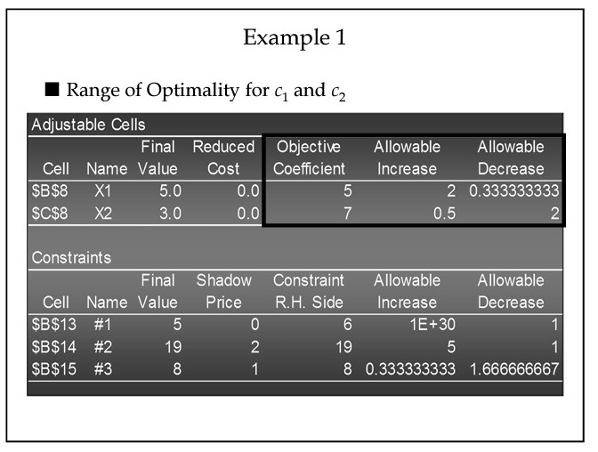

Slide 59
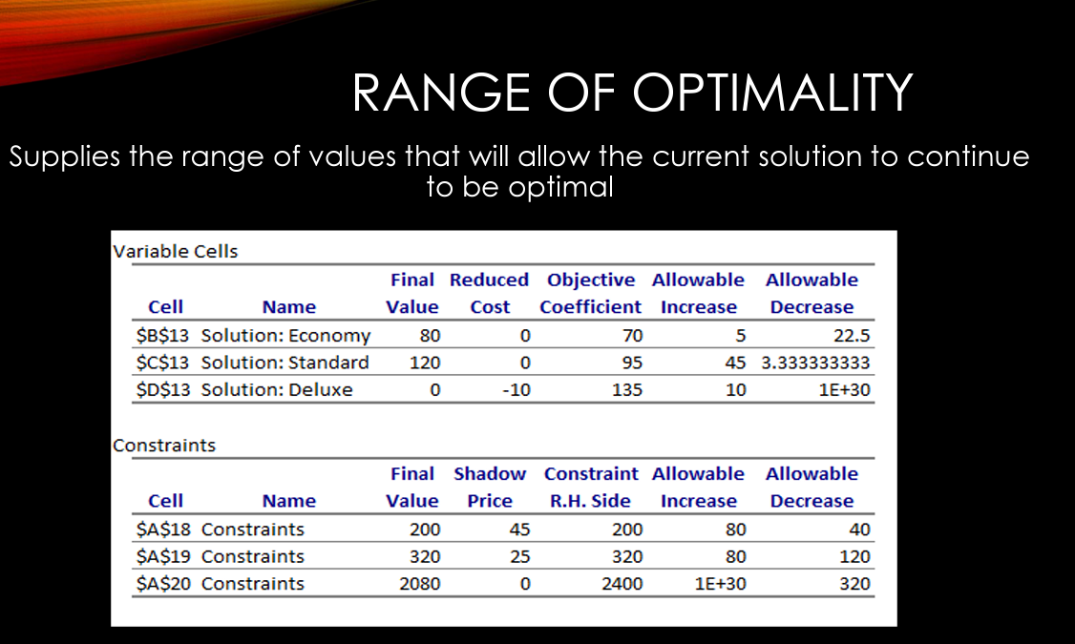

Slide 60
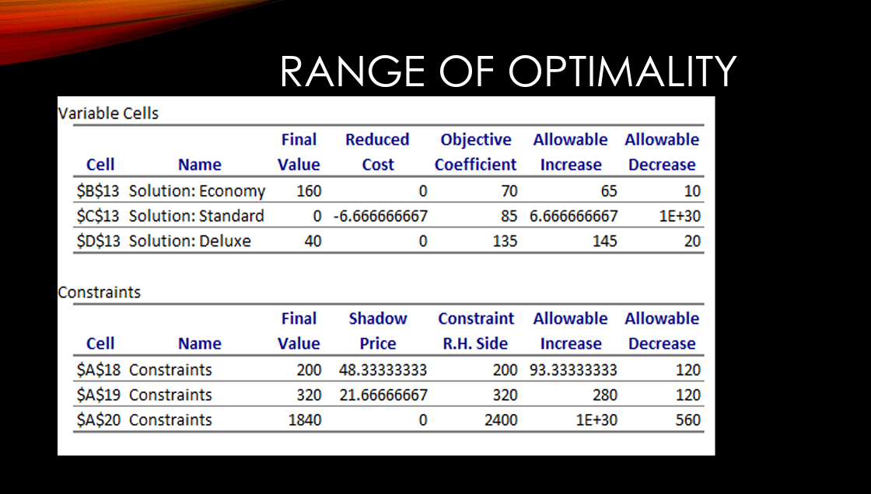

Slide 61
TERMS

Slide 62
Example: Sensitivity Analysis
Shadow Prices
Constraint 1: Since x₁ < 6 is not a binding constraint, its shadow price is 0.
Constraint 2: Change the RHS value of the second constraint to 20 and resolve for the optimal point determined by the last two constraints:
2x₁ + 3x₂ = 20 and x₁ + x₂ = 8.
The solution is x₁ = 4, x₂ = 4, z = 48. Hence, the
shadow price = z_{new} - z_{old} = 48 - 46 = 2.

Slide 63
Example: Sensitivity Analysis
Shadow Prices (continued)
Constraint 3: Change the RHS value of the third constraint to 9 and resolve for the optimal point determined by the last two constraints:
2x₁ + 3x₂ = 19 and x₁ + x₂ = 9.
The solution is: x₁ = 8, x₂ = 1, z = 47. Hence, the shadow price is z_{new} - z_{old} = 47 - 46 = 1.

Slide 64
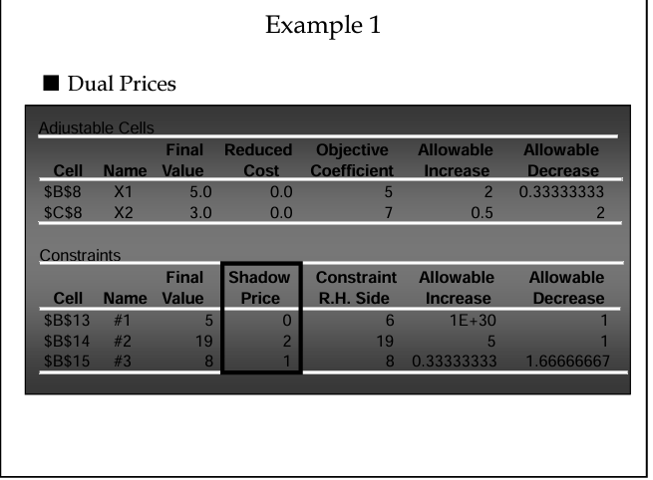

Slide 65
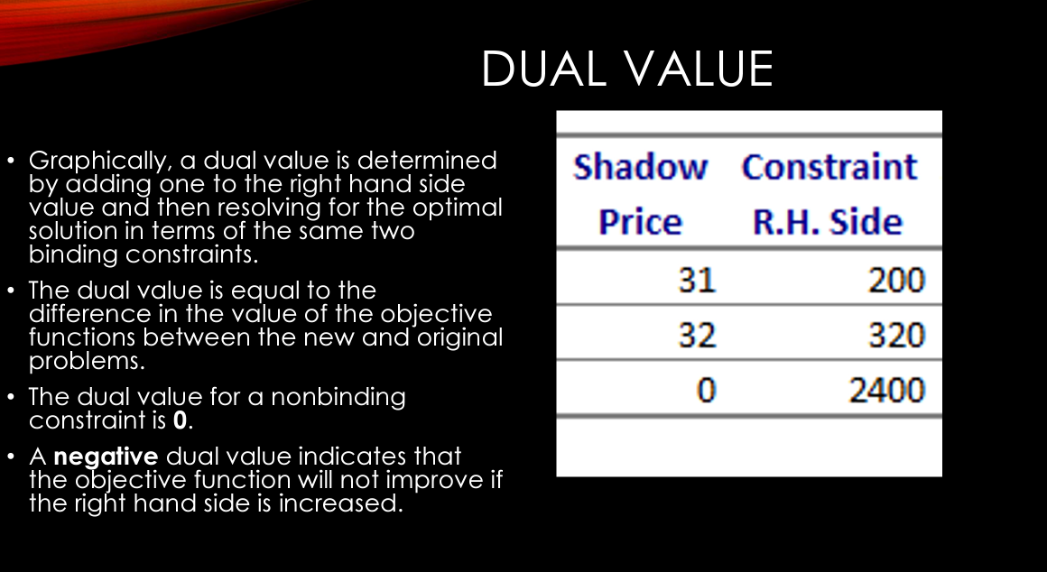
Dual Value

Slide 66
• The dual value is equal to the difference in the value of the objective functions between the new and original problems.
• The dual value for a nonbinding constraint is 0.
• A negative dual value indicates that the objective function will not improve if the right hand side is increased.

Slide 67
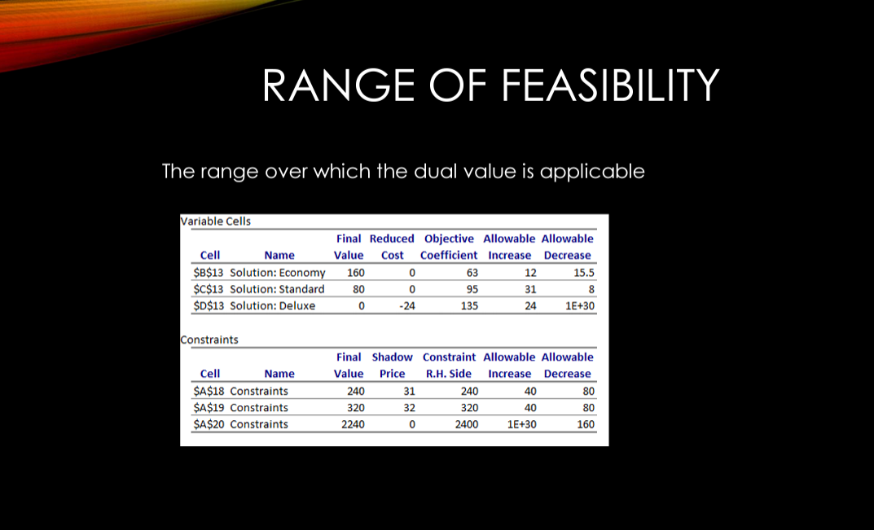

Slide 68
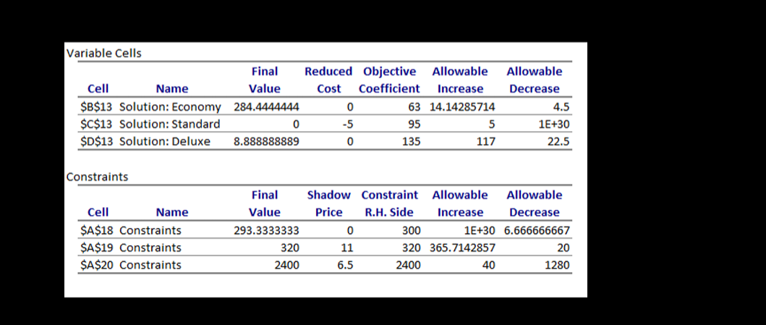
REDUCED COST
The reduced cost associated with a variable is equal to the dual value of the non-negativity constrain associated with the variable.
In general, if a variable has a non-zero value in the optimal solution, then it will have a reduced cost equal to 0.

Slide 69
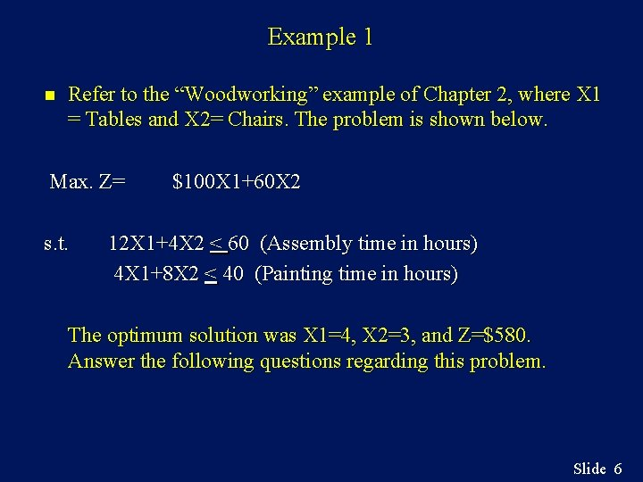

Slide 70
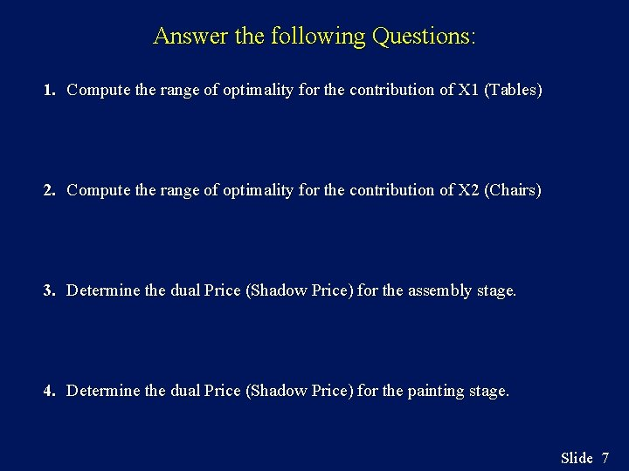

Slide 71
LIMITATIONS OF CLASSICAL SENSITIVITY ANALYSIS
• Simultaneous Changes - The range analysis for objective function coefficients and the constraint right-hand sides is only applicable for changes in a single coefficient.
• Changes in Constraint Coefficients – Classical sensitivity analysis provides no information about changes resulting from a change in a coefficient of a variable in a constraint.

Slide 72
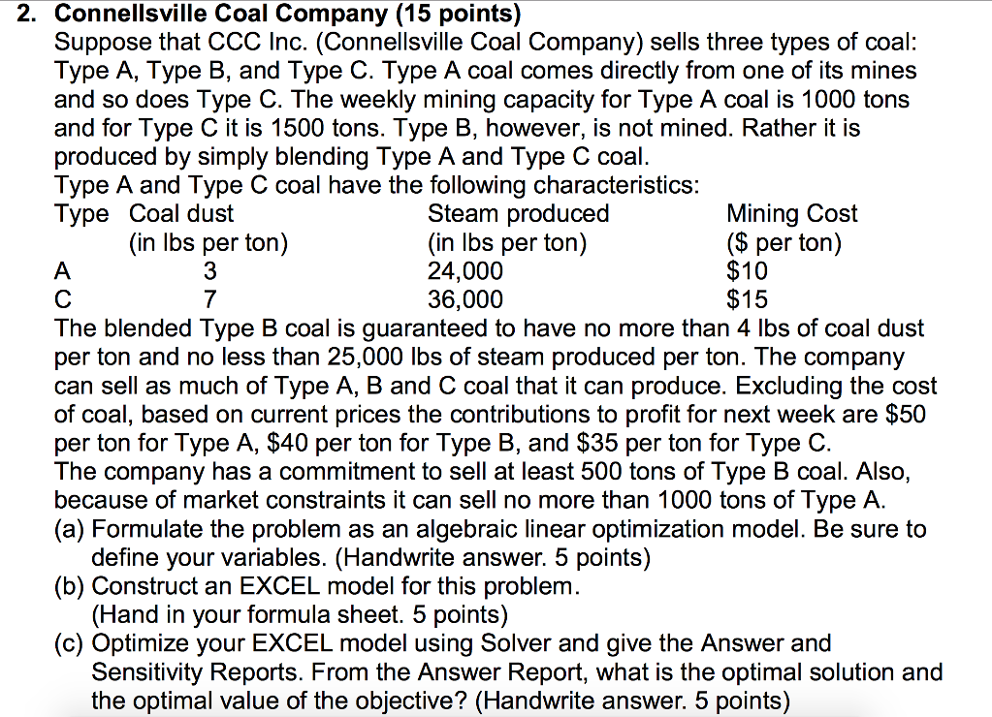

Slide 73
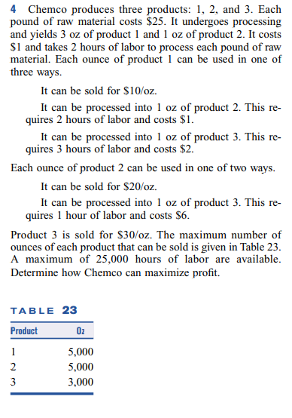

Slide 74
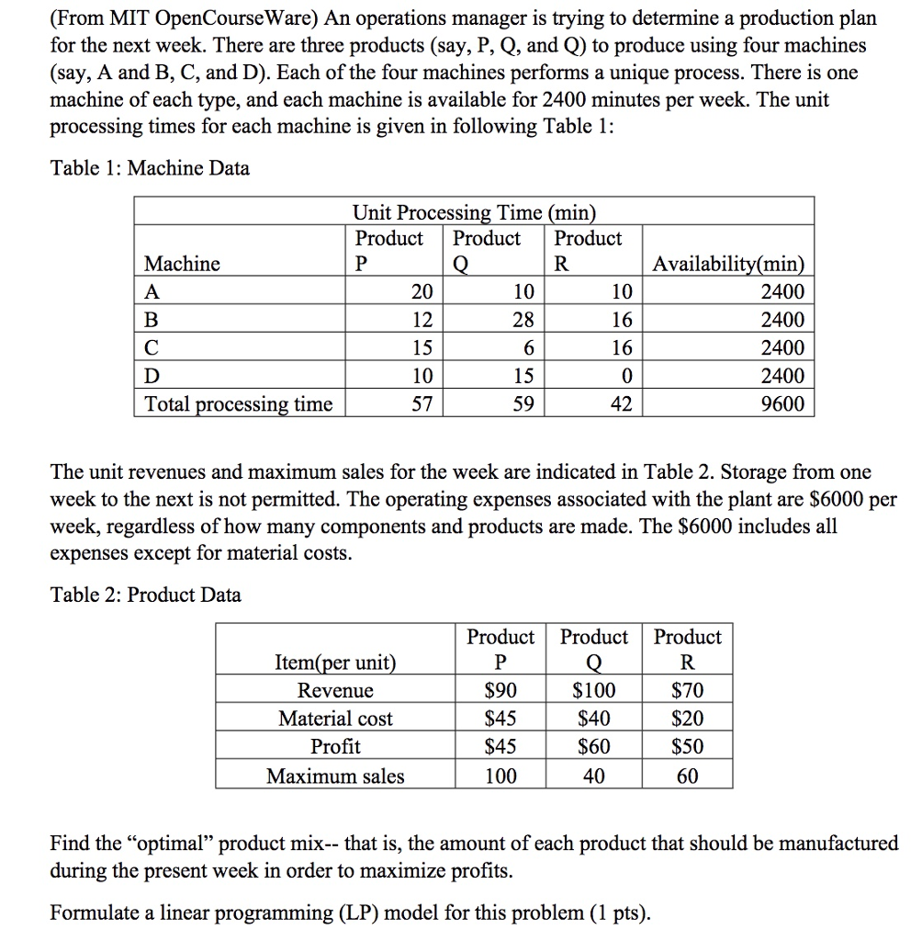

Slide 75
Example: Infeasible Problem
Solve graphically for the optimal solution:
Max z = 2x₁ + 6x₂
s.t. 4x₁ + 3x₂ < 12
2x₁ + x₂ > 8
x₁, x₂ > 0

Slide 76
Example: Infeasible Problem
There are no points that satisfy both constraints, hence this problem has no feasible region, and no optimal solution.
x₂
2x₁ + x₂ > 8
8
4x₁ + 3x₂ < 12
4
x₁
3
4

Slide 77
Example: Unbounded Problem
Solve graphically for the optimal solution:
Max z = 3x₁ + 4x₂
s.t. x₁ + x₂ > 5
3x₁ + x₂ > 8
x₁, x₂ > 0

Slide 78
Example: Unbounded Problem
The feasible region is unbounded and the objective function line can be moved parallel to itself without bound so that z can be increased infinitely.
x₂
3x₁ + x₂ > 8
8
x₁ + x₂ > 5
5
Max 3x₁ + 4x₂
x₁
2.67
5

